Slide 1
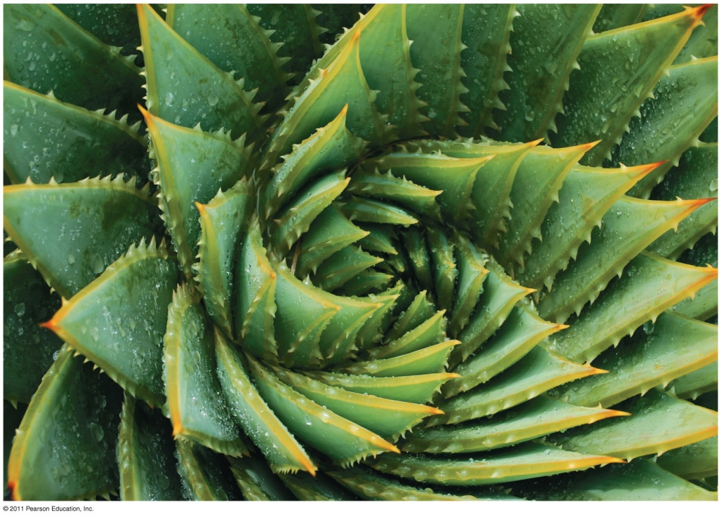
Chapter 8
Introduction to Metabolism

Slide 2
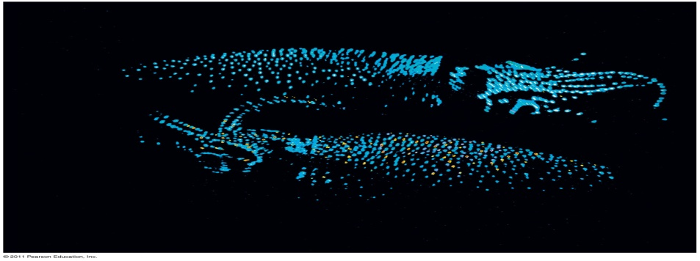
The Energy of Life
The living cell is a miniature chemical factory where thousands of reactions occur
The cell extracts energy and applies energy to perform work
Some organisms even convert energy to light, as in bioluminescence

Slide 3
matter and energy
An organism’s metabolism transforms matter and energy, subject to the laws of thermodynamics
Metabolism is the totality of an organism’s chemical reactions
Metabolism is a property of life that arises from interactions between molecules within the cell

Slide 4
Organization of the Chemistry of Life into Metabolic Pathways
A metabolic pathway begins with a specific molecule and ends with a product
Each step is catalyzed by a specific enzyme
Enzyme 1
Enzyme 2
Enzyme 3
A
B
C
D
Reaction 1
Reaction 2
Reaction 3
Starting molecule
Product

Slide 5
Metabolic Pathways
Catabolic pathways release energy by breaking down complex molecules into simpler compounds
Cellular respiration, the breakdown of glucose in the presence of oxygen, is an example of a pathway of catabolism

Slide 6
Metabolic Pathways
Anabolic pathways consume energy to build complex molecules from simpler ones
The synthesis of protein from amino acids is an example of anabolism
Bioenergetics is the study of how organisms manage their energy resources

Slide 7
Forms of Energy
Energy is the capacity to cause change
Energy exists in various forms, some of which can perform work

Slide 8
Forms of Energy
Kinetic energy is energy associated with motion
Heat (thermal energy) is kinetic energy associated with random movement of atoms or molecules
Potential energy is energy that matter possesses because of its location or structure
Chemical energy is potential energy available for release in a chemical reaction
Energy can be converted from one form to another

Slide 9
Forms of Energy
A diver has more potential energy on the platform than in the water.
Diving converts potential energy to kinetic energy.
Climbing up converts the kinetic energy of muscle movement to potential energy.
A diver has less potential energy in the water than on the platform.

Slide 10
The Laws of Energy Transformation
Thermodynamics is the study of energy transformations
A isolated system, such as that approximated by liquid in a thermos, is isolated from its surroundings
In an open system, energy and matter can be transferred between the system and its surroundings
Organisms are open systems

Slide 11
The First Law of Thermodynamics
According to the first law of thermodynamics, the energy of the universe is constant
Energy can be transferred and transformed, but it cannot be created or destroyed
The first law is also called the principle of conservation of energy

Slide 12
The Second Law of Thermodynamics
During every energy transfer or transformation, some energy is unusable, and is often lost as heat
According to the second law of thermodynamics
Every energy transfer or transformation increases the entropy (disorder) of the universe

Slide 13
The Second Law of Thermodynamics
Heat
Chemical energy
First law of thermodynamics
Second law of thermodynamics

Slide 14
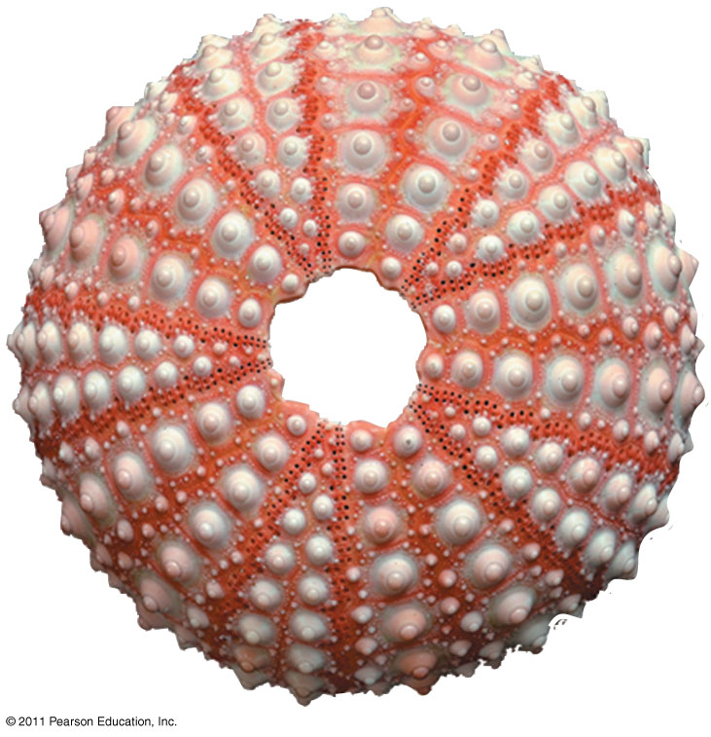
Biological Order and Disorder
Cells create ordered structures from less ordered materials
Organisms also replace ordered forms of matter and energy with less ordered forms
Energy flows into an ecosystem in the form of light and exits in the form of heat

Slide 15
The free-energy change of a reaction tells us whether or not the reaction occurs spontaneously
Biologists want to know which reactions occur spontaneously and which require input of energy
To do so, they need to determine energy changes that occur in chemical reactions

Slide 16
Free-Energy Change, ΔG
A living system’s free energy is energy that can do work when temperature and pressure are uniform, as in a living cell

Slide 17
Free-Energy Change, ΔG
The change in free energy (∆G) during a process is related to the change in enthalpy, or change in total energy (∆H), change in entropy (∆S), and temperature in Kelvin (T)
∆G = ∆H – T∆S
Only processes with a negative ∆G are spontaneous
Spontaneous processes can be harnessed to perform work

Slide 18
Free Energy, Stability, and Equilibrium
Free energy is a measure of a system’s instability, its tendency to change to a more stable state
During a spontaneous change, free energy decreases and the stability of a system increases
Equilibrium is a state of maximum stability
A process is spontaneous and can perform work only when it is moving toward equilibrium

Slide 19
Free Energy, Stability, and Equilibrium
• More free energy (higher G) • Less stable • Greater work capacity
In a spontaneous change • The free energy of the system decreases (ΔG < 0) • The system becomes more stable • The released free energy can be harnessed to do work
Less free energy (lower G) • More stable • Less work capacity
Gravitational motion
Diffusion
Chemical reaction

Slide 20
Free Energy and Metabolism
The concept of free energy can be applied to the chemistry of life’s processes

Slide 21
Exergonic and Endergonic Reactions in Metabolism
An exergonic reaction proceeds with a net release of free energy and is spontaneous
An endergonic reaction absorbs free energy from its surroundings and is nonspontaneous

Slide 22
Exergonic
Exergonic reaction: energy released, spontaneous
Reactants
Amount of energy released (ΔG < 0)
Energy
Free energy
Products
Progress of the reaction

Slide 23
Endergonic
Endergonic reaction: energy required, nonspontaneous
Products
Amount of energy required (ΔG > 0)
Free energy
Reactants
Energy
Progress of the reaction

Slide 24
Equilibrium and Metabolism
Reactions in a closed system eventually reach equilibrium and then do no work
Cells are not in equilibrium; they are open systems experiencing a constant flow of materials
A defining feature of life is that metabolism is never at equilibrium
A catabolic pathway in a cell releases free energy in a series of reactions
Closed and open hydroelectric systems can serve as analogies

Slide 25
Equilibrium and Metabolism
ΔG < 0
ΔG = 0
An isolated hydroelectric system

Slide 26
Equilibrium and Metabolism
An open hydroelectric system

Slide 27
ATP powers cellular work by coupling exergonic reactions to endergonic reactions
A cell does three main kinds of work
Chemical
Transport
Mechanical
To do work, cells manage energy resources by energy coupling, the use of an exergonic process to drive an endergonic one
Most energy coupling in cells is mediated by ATP

Slide 28
The Structure and Hydrolysis of ATP
ATP (adenosine triphosphate) is the cell’s energy shuttle
ATP is composed of ribose (a sugar), adenine (a nitrogenous base), and three phosphate groups

Slide 29
The structure of ATP
Adenine
Phosphate groups
Ribose

Slide 30
The hydrolysis of ATP
Adenosine triphosphate (ATP)
Energy
Inorganic phosphate
Adenosine diphosphate (ADP)

Slide 31
ATP
The bonds between the phosphate groups of ATP’s tail can be broken by hydrolysis
Energy is released from ATP when the terminal phosphate bond is broken
This release of energy comes from the chemical change to a state of lower free energy, not from the phosphate bonds themselves

Slide 32
How the Hydrolysis of ATP Performs Work
The three types of cellular work (mechanical, transport, and chemical) are powered by the hydrolysis of ATP
In the cell, the energy from the exergonic reaction of ATP hydrolysis can be used to drive an endergonic reaction
Overall, the coupled reactions are exergonic

Slide 33
How the Hydrolysis of ATP Performs Work
ATP drives endergonic reactions by phosphorylation, transferring a phosphate group to some other molecule, such as a reactant
The recipient molecule is now called a phosphorylated intermediate

Slide 34
How the Hydrolysis of ATP Performs Work
Transport protein
Solute
ATP
ADP
P _{i}
Solute transported
Transport work: ATP phosphorylates transport proteins.
Vesicle
ATP
ADP
P _{i}
ATP
Protein and vesicle moved
Motor protein
Mechanical work: ATP binds noncovalently to motor proteins and then is hydrolyzed.

Slide 35
The Regeneration of ATP
ATP is a renewable resource that is regenerated by addition of a phosphate group to adenosine diphosphate (ADP)
The energy to phosphorylate ADP comes from catabolic reactions in the cell
The ATP cycle is a revolving door through which energy passes during its transfer from catabolic to anabolic pathways

Slide 36
ATP Cycle
ATP
H₂O
Energy from catabolism (exergonic, energy-releasing processes)
Energy for cellular work (endergonic, energy-consuming processes)
ADP
P _{i}

Slide 37
Enzymes speed up metabolic reactions by lowering energy barriers
A catalyst is a chemical agent that speeds up a reaction without being consumed by the reaction
An enzyme is a catalytic protein
Hydrolysis of sucrose by the enzyme sucrase is an example of an enzyme-catalyzed reaction

Slide 38
Enzymes
Sucrase
Sucrose (C₁₂H₂₂O₁₁)
Glucose (C₆H₁₂O₆)
Fructose (C₆H₁₂O₆)

Slide 39
The Activation Energy Barrier
Every chemical reaction between molecules involves bond breaking and bond forming
The initial energy needed to start a chemical reaction is called the free energy of activation, or activation energy (E_{A})
Activation energy is often supplied in the form of thermal energy that the reactant molecules absorb from their surroundings

Slide 40
How Enzymes Lower the E_{A} Barrier
Enzymes catalyze reactions by lowering the E_{A} barrier
Enzymes do not affect the change in free energy (∆G); instead, they hasten reactions that would occur eventually

Slide 41
How Enzymes Lower the E_{A} Barrier
Course of reaction without enzyme
E_{A} without enzyme
E_{A} with enzyme is lower
Reactants
Course of reaction with enzyme
ΔG is unaffected by enzyme
Free energy
Progress of the reaction
Products

Slide 42
Substrate Specificity of Enzymes
The reactant that an enzyme acts on is called the enzyme’s substrate
The enzyme binds to its substrate, forming an enzyme-substrate complex
The active site is the region on the enzyme where the substrate binds
Induced fit of a substrate brings chemical groups of the active site into positions that enhance their ability to catalyze the reaction

Slide 43
Substrate Specificity of Enzymes
Substrate
Active site
Enzyme
Enzyme-substrate complex

Slide 44
Catalysis in the Enzyme’s Active Site
In an enzymatic reaction, the substrate binds to the active site of the enzyme
The active site can lower an E_{A} barrier by
Orienting substrates correctly
Straining substrate bonds
Providing a favorable microenvironment
Covalently bonding to the substrate

Slide 45
Catalysis in the Enzyme’s Active Site
Substrates enter active site.
Substrates are held in active site by weak interactions.
Substrates
Enzyme-substrate complex
Active site is available for two new substrate molecules.
Active site can lower E_{A} and speed up a reaction.
Enzyme
Products are released.
Substrates are converted to products.
Products

Slide 46
Effects of Local Conditions on Enzyme Activity
An enzyme’s activity can be affected by
General environmental factors, such as temperature and pH
Chemicals that specifically influence the enzyme

Slide 47
Effects of Temperature and pH
Each enzyme has an optimal temperature in which it can function
Each enzyme has an optimal pH in which it can function
Optimal conditions favor the most active shape for the enzyme molecule

Slide 48
Optimal pH for pepsin (stomach enzyme
Optimal pH for trypsin (intestinal enzyme
Rate of reaction
0
4
pH
10
Optimal pH for two enzymes

Slide 49
Cofactors
Cofactors are nonprotein enzyme helpers
Cofactors may be inorganic (such as a metal in ionic form) or organic
An organic cofactor is called a coenzyme
Coenzymes include vitamins

Slide 50
Enzyme Inhibitors
Competitive inhibitors bind to the active site of an enzyme, competing with the substrate
Noncompetitive inhibitors bind to another part of an enzyme, causing the enzyme to change shape and making the active site less effective
Examples of inhibitors include toxins, poisons, pesticides, and antibiotics

Slide 51
Normal binding
Competitive inhibition
Noncompetitive inhibition
Competitive inhibitor
Noncompetitive inhibitor

Slide 52
The Evolution of Enzymes
Enzymes are proteins encoded by genes
Changes (mutations) in genes lead to changes in amino acid composition of an enzyme
Altered amino acids in enzymes may alter their substrate specificity
Under new environmental conditions a novel form of an enzyme might be favored

Slide 53
Regulation of enzyme activity helps control metabolism
Chemical chaos would result if a cell’s metabolic pathways were not tightly regulated
A cell does this by switching on or off the genes that encode specific enzymes or by regulating the activity of enzymes

Slide 54
Allosteric Regulation of Enzymes
Allosteric regulation may either inhibit or stimulate an enzyme’s activity
Allosteric regulation occurs when a regulatory molecule binds to a protein at one site and affects the protein’s function at another site

Slide 55
Allosteric Activation and Inhibition
Most allosterically regulated enzymes are made from polypeptide subunits
Each enzyme has active and inactive forms
The binding of an activator stabilizes the active form of the enzyme
The binding of an inhibitor stabilizes the inactive form of the enzyme

Slide 56
Allosteric Activation and Inhibition
Allosteric activators and inhibitors
Active site (one of four)
Allosteric enzyme with four subunits
Activator
Active form
Stabilized active form
Oscillation
Nonfunctional active site
Inactive form
Inhibitor
Stabilized inactive form

Slide 57
Cooperativity
Cooperativity: another type of allosteric activation
Substrate
Inactive form
Stabilized active form

Slide 58
Cooperativity
Cooperativity is a form of allosteric regulation that can amplify enzyme activity
One substrate molecule primes an enzyme to act on additional substrate molecules more readily
Cooperativity is allosteric because binding by a substrate to one active site affects catalysis in a different active site

Slide 59
Identification of Allosteric Regulators
Allosteric regulators are attractive drug candidates for enzyme regulation because of their specificity
Inhibition of proteolytic enzymes called caspases may help management of inappropriate inflammatory responses

Slide 60
Feedback Inhibition
In feedback inhibition, the end product of a metabolic pathway shuts down the pathway
Feedback inhibition prevents a cell from wasting chemical resources by synthesizing more product than is needed

Slide 61
Specific Localization of Enzymes Within the Cell
Structures within the cell help bring order to metabolic pathways
Some enzymes act as structural components of membranes
In eukaryotic cells, some enzymes reside in specific organelles; for example, enzymes for cellular respiration are located in mitochondria

Slide 62
Mitochondria
Mitochondria
The matrix contains enzymes in solution that are involved in one stage of cellular respiration
Enzymes for another stage of cellular respiration are embedded in the inner membrane.

